Slide 1

Windows 2000 Processes and Threads
Computing Department,
Lancaster University, UK

Slide 2
Overview
Goals
  Quick overview of Windows 2000 management mechanisms
    The registry, Services, Windows Management Instrumentation
  Processes and Threads
    Processes and threads in further detail

Slide 3
Management Mechanisms:
The Registry
Repository for system/user configuration information
  Contains information Windows 2000 requires to boot & configure as well as current running system dynamic status information
Most common registry parameters can be adjusted using a graphical utility
  Advanced tuning/configuration requires direct access
    Regedt32 or Regedit
Organised to “hives”
  Pieces of the registry database stored in different files

Slide 4
Management Mechanisms:
Registry Organisation
Five main hives for location machine information
  \HKEY_LOCAL_MACHINE\System
    Controls booting and running the system
  \HKEY_LOCAL_MACHINE\Hardware
    Hardware configuration data, resource usage
    Volatile (not saved across boots)
  \HKEY_LOCAL_MACHINE\Software
    Per-machine software data (not critical for booting)
  \HKEY_LOCAL_MACHINE\SAM
    Account & groups database (replicated on domain controllers)
  \HKEY_LOCAL_MACHINE\Security
    System-wide security policies (on domain controllers)

Slide 5
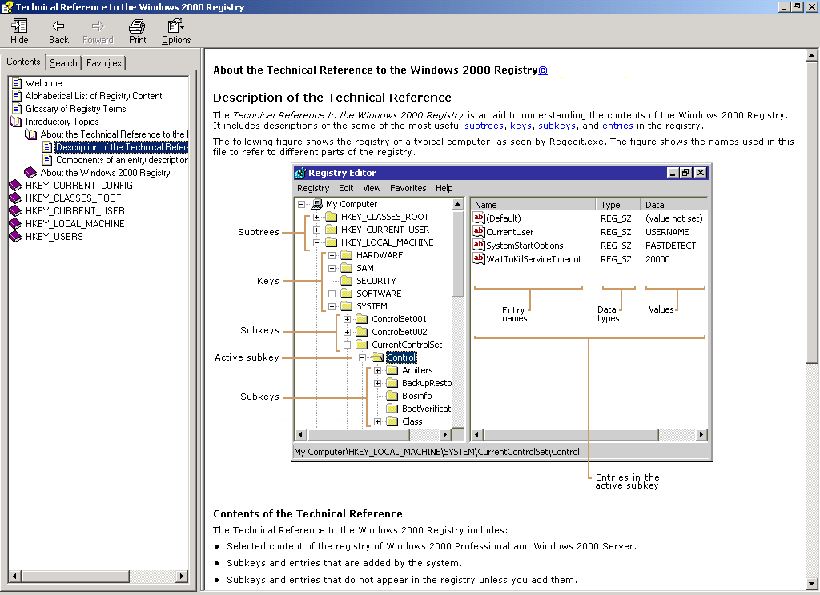
Management Mechanisms:
Technical Reference to The Windows 2000 Registry

Slide 6
Management Mechanisms:
Services
Processes started at system startup time that provide services not tied to an interactive user
  Started regardless of whether anyone is logged in
Similar to UNIX daemon processes – often implement the server side of client / server app.
Services consist of three components:
  A service application
  A service control program (SCP)
    Used by a user to start, stop or configure the service
  A service control manager (SCM)
    Started by the winlogon process
    Orchestrates the launching of services that are configured for automatic start-up
    Stores each characteristic of a service in the service’s registry key

Slide 7
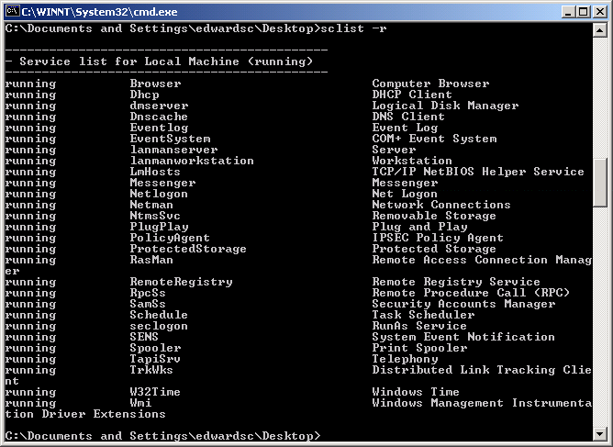
Management Mechanisms:
Example Services

Slide 8
Management Mechanisms:
Windows Management Instrumentation
Implementation of Web-Based Enterprise Management (WBEM)
  Initiative to establish standards for accessing and sharing management information over an enterprise network
  Supports the Common Information Model (CIM) used to describe objects in a management environment
The WMI control enables you to perform Windows Management configuration tasks, such setting permissions of users / authorised groups
In Windows 2000, several management tools are WMI enabled:
  Logical drives – manage mapped drives and local drives
  System properties – view and change properties on local or remote machines
  System information – collects and displays configuration information about your system

Slide 9
Windows 2000 Architecture
Replicator
Alerter
Event Log
Win32
POSIX
OS/2
Session Mgr
WinLogon
System
Processes
Services
User Apps
Environment
Subsystems
Interface DLL
Subsystem DLL
User
Kernel
Executive Services API
I/O
System
Security
Monitor
Win32
GDI
Object
Services
Memory
Mgmt
Processes/
Threads
File
Systems
Object Management
Device
Drivers
Kernel
Exec.
RTL
Hardware Abstraction Layer (HAL)
Registry
I/O
Devices
DMA/Bus
Control
Cache
Control
Clocks/
Timers
Privileged
Architecture
Interrupt
Dispatch

Slide 10



Processes, Threads and Jobs
Executive
Executive
What is a process?
  Represents an instance of a running program
    You create a process to run a program
    Starting an application creates a process
What is a thread?
    An execution context within a process
    All threads in a process share the same per-process address space
What is a job?
    Allows groups of process to be managed as a single unit
Per-process
address space
Thread
Thread
Thread
Systemwide
Address Space

Slide 11
Processes – Further Detail
Each process has its own…
  Virtual address space
    Processes cannot corrupt each other’s address space
  Working set
    Physical memory owned by the process
  Access token
    Includes security identifiers
  Handle table for Win32 kernel objects
Common to all threads in the process – but separate and protected between processes

Slide 12
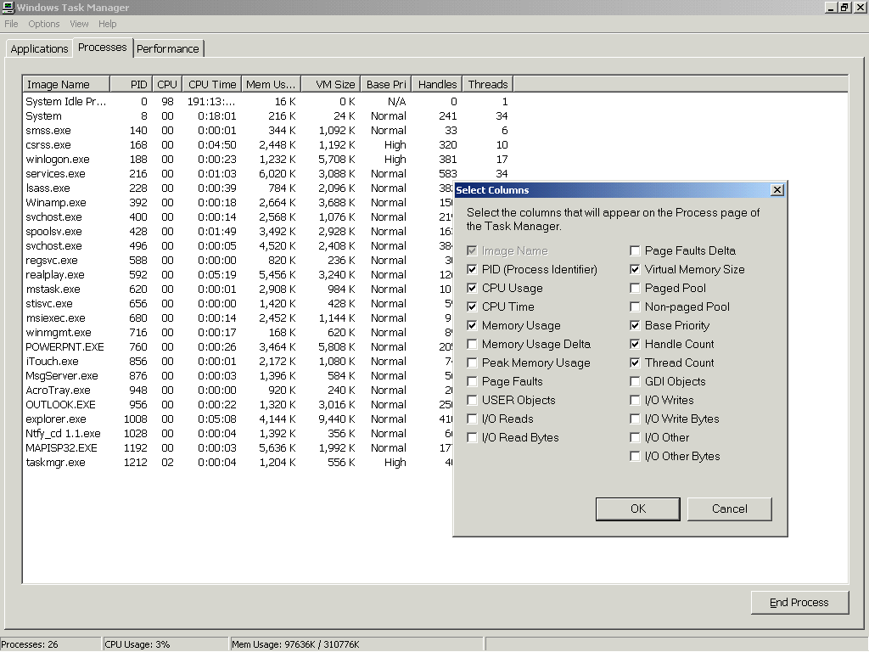
Viewing Process Information
Using Task Manager

Slide 13
Viewing Process Information
Using Process Viewer
Demo…
Pview.exe provided with Windows 2000 Support Tools
  (also available on platform SDK)
What you get:
  Memory management details
  Kill capabilities
  Processor time columns show the total processor time the process or thread has used since creation
  Priority levels

Slide 14
Threads – Further Detail
Each thread has its own…
  Stack
  Scheduling state (Wait, Ready, Running, etc..)
  Scheduling priority
  Current access mode (user mode or kernel mode)
  Saved CPU state if it isn’t running

Slide 15
Viewing Thread Information
Using Tlist
Demo…
Tlist utility is available in the Windows 2000 Support Tools
What you get:
  Thread ID
  Win32 start address
  Thread state
  Last error

Slide 16
Fibers
Often called “lightweight threads”…
Fibers allow an application to schedule its own “threads” of execution
  Rather than relying in priority-based scheduling
Implemented completely in User Mode
  In terms of scheduling, they are invisible to the kernel
  No ramifications to the “internals”
  Implemented in Kernel32.dll

Slide 17
Fibers (2)
Fiber APIs available
  Allow different execution contexts
    Stack
    Fiber-local storage
    Some registers
Analogous to threading libraries under many Unix systems
Function available to convert a thread to a running fiber
  ConvertThreadToFiber function
Allows easy porting for applications that “did their own threads”…

Slide 18
Win32 Process APIs
CreateProcess
OpenProcess
GetCurrentProcessId – returns a global process ID
GetCurrentProcess – returns a handle to the process
ExitProcess
TerminateProcess – no DLL notification
Get/SetProcessShutdownParameters
GetExitCodeProcess
GetProcessTimes
GetStartupInfo

Slide 19
Win32 Thread APIs
CreateThread
CreateRemoteThread – Creates a thread in another process
GetCurrentThreadId – Returns global ID
ExitThread – Ends execution normally
TerminateThread – no DLL notification
GetExitCodeThread – gets another thread’s exit code
GetThreadTimes – Returns another thread’s timing info.
Get/SetThreadContext – Returns or changes a thread’s CPU registers

Slide 20
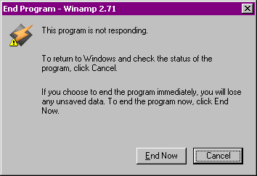
Exiting of Processes
Normal – Application decides to exit (ExitProcess)
  Usually due to a request from the UI
Orderly exit requested from the desktop (ExitProcess)
  e.g. “End Task” from the “Applications” tab
Forced termination (TerminateProcess)
  If no response to “End Task” in 5 seconds…
  →
  “End Now” does a
  TerminateProcess

Slide 21
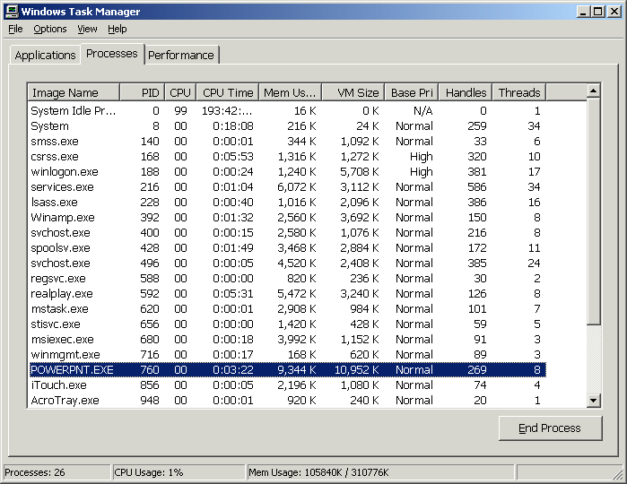
Forced Termination (cont.)
“Kill Process” from Process Viewer forces a TerminateProcess
“End Process” from Task Manager “Processes” Tab forces a TerminateProcess

